Slide 1
Naive Bayes Classification, Features, Linear Models, Perceptron
USC VSoE CSCI 544: Applied Natural Language Processing
Jonathan May -- 梅約納
Nanyun (Violet) Peng -- 彭楠赟
September 5, 2018
based on Nathan Schneider's slides
Notes:
add feature engineering http://people.cs.georgetown.edu/cosc572/f16/07_linear-models_slides.pdf
add maxent http://www.inf.ed.ac.uk/teaching/courses/fnlp/lectures/07_slides.pdf
but need to understand training!
or maybe parts of http://people.cs.georgetown.edu/cosc572/f16/08_discriminative_slides.pdf

Slide 2
Sentiment Analysis
Recall the task:
This is a classification task: our input is free text but our output is a fixed set of labels
In this lecture, input/observed data is denoted x (or set X) and output/prediction is y (or set Y)
C

Slide 3
Our Previous Rule-Based Classifier
good = { 'yay', 'love', ...}
bad = { 'terrible', 'boo', ...}
score = 0
for w in x:
if w in good:
score +=1
elif w in bad:
score -=1
if score >= 0:
return 'pos'
return 'neg'
from our pos/neg
word list!
Note: example
code from lecture 2
is slightly different but
functionally equivalent
x
C
y

Slide 4
Supervised Classification
Rather than top-down features, let's use data-driven features
Our intuitions about word sentiment aren't perfect
Supervised (aka Inductive) = learn from labeled examples. Recipe:
training corpus of (x, y) (review, label) pairs
learning algorithm
Other kinds of learning (not covered here):
Unsupervised: Data is provided but no labels are given
Semi-Supervised: Data is provided but only some of it is labeled
Reinforcement: No clear labels, but feedback (in the form of a reward) is accessible

Slide 5
Our Previous Rule-Based Classifier
Supervised
good = { ... from training ...}
bad = { ... from training ...}
score = 0
for w in x:
if w in good:
score +=1
elif w in bad:
score -=1
if score >= 0:
return 'pos'
return 'neg'
x
C
y

Slide 6
Notation
Training examples: X = (x₁, x₂, ..., x_{N})
Labels of training examples: Y = (y₁, y₁, ..., y_{N})
A classifier C maps x_{i} to y_{i}
A learner L infers C from (X, Y)
x_{i}
C
y_{i}
X
L
C
Y

Slide 7
Counting-based Learner
from collections import Counter
scores = Counter()
for x, y in zip(X, Y):
for w in x:
if y == 'pos':
scores[w]+=1
elif y == 'neg':
scores[w]-=1
good, bad = set(), set()
for w, score in scores.items():
if score>=0: good.add(w)
else: bad.add(w)
return good, bad
X
Y
L
C

Slide 8
A Probabilistic Classifier
Review #34925: "Filled with horrific dialogue, laughable characters, a laughable plot, and really no interesting stakes during this film, "Star
Wars Episode I: The Phantom Menace" is not at all what I wanted from a film that is supposed to be the huge opening to the segue into the fantastic Original Trilogy. The positives include the score, the sound..."
Experiment: "people wrote reviews of movies"
Outcomes (Ω): all possible reviews
Events: Y=pos: all positive reviews. Y=neg = all negative reviews X=34925: "when review 34925 was written"
probs = <model for p(y|X)>
return argmax probs[X]
x
C
y
MLE is not going to work (review 34925 shouldn't be in training)!

Slide 9
Aside: Library of Babel (Borges, 1941)
Contains all 1.3m-word texts, organized
A lot of it looks like junk
But all useful texts are in here too!
What's it like to be a librarian?
Look up your favorite piece of text at https://libraryofbabel.info

Slide 10
A probabilistic model that generalizes
Instead of estimating p(Y|Filled with horrific...) directly, let's make two modeling assumptions:
The Bag of Words (BoW) assumption: Assume the order of the words in the document doesn't matter: p(Y|Filled with horrific ...) = P(Y|with, horrific, Filled, ...)
a sequence
independent word events

Slide 11
6.1

Slide 12
A probabilistic model that generalizes
Instead of estimating p(Y|Filled with horrific...) directly, let's make two modeling assumptions:
The Bag of Words (BoW) assumption: Assume the order of the words in the document doesn't matter: p(Y|Filled with horrific ...) = P(Y|with, horrific, Filled, ...) So called because a bag or multiset is a data structure that stores counts of elements, but not their order
a sequence
independent word events

Slide 13
A probabilistic model that generalizes
The BoW assumption isn't enough unless you happen to have seen one of 34925's anagrams in your training data (e.g. 4088293). Hence:
The naive Bayes assumption: Words are independent conditioned on their class: P(Filled, with, horrific... | Y) = P(Filled | Y) x P(with | Y) x P(horrific | Y) ... Instead of P(Filled | Y, with, horrific, ...) x P(with | Y, horrific, ...) x P(horrific | Y, ...) ...
Wait, but we were estimating P(Y|with, horrific, Filled, ...). What should we do?
Bayes Rule!

Slide 14
A probabilistic model that generalizes
Put the assumptions/rule together:
p(Y|Filled with horrific ...) = P(Y|with, horrific, Filled, ...) (BoW assmptn)
∝ P(Y) x P(with, horrific, Filled, ...|Y) (Bayes' rule)
= P(Y) x P(with|Y) x P(horrific|Y) x P(Filled|Y)... (Naive Bayes assmptn)

Slide 15
Is this a good model?
"all models are wrong, but some are useful" – George Box, statistician
What's wrong with the BoW assumption?
What's wrong with the Naive Bayes assumption?
But does it work?
Yes, for many tasks
And that's kind of all that matters

Slide 16
Naive Bayes Classifier
from numpy import argmax
wprobs = { from training }
cprobs = { from training }
totals = []
for c in classes:
total = class_probs[c]
for w in x:
total *= wprobs[w][c]
totals.append(total)
return argmax(totals)
x
C
y

Slide 17
Naive Bayes Learner
from collections import Counter
cscores = Counter()
wscores = []
for c in classes:
wscores.append(Counter())
for x, y in zip(X, Y):
cscores[y]+=1
for w in x.split():
wscores[y][w]+=1
cprobs, wprobs = [], []
for c in classes:
cprobs.append(cscores[c]/len(Y))
wprob = {}
for w, score in wscores[c].items():
wprob[w] = score/cscores[c]
wprobs.append(wprob)
return cprobs, wprobs
X
Y
L
C

Slide 18
Parameters
Every probability or other value that is learned and used by the classifier is called a parameter (e.g. everything the learner sent the classifier)
Naive Bayes has two kinds of parameters:
Class prior distribution P(Y) = belief in the class
Likelihood distribution P(W|Y) = likelihood of observing a word in a class
If there are K classes and V words, how many parameters are in a Naive Bayes classifier?
Notes:
K+KV

Slide 19
Practicalities: Smoothing
Recall: for w in x: total *= wprobs[w][c]
What if you see a new word, or word unassociated with that class, at test time?
Whole probability will be 0!

Slide 20
Laplace (add-1) smoothing
Assume we've seen a special symbol called OOV (out of vocabulary) once per class. And assume we've seen all possibilities once more.
Before: p(wonderful | pos) = count(wonderful, pos)/count(*, pos) p(terrible | pos) = count(terrible, pos) = 0/count(*, pos) = 0!
vocabulary | pos | neg
wonderful | 398 | 17
terrible | 0 | 228
... | ... | ...
TOTAL (5000 types) | 147808 | 167585

Slide 21
Laplace (add-1) smoothing
Assume we've seen a special symbol called OOV (out of vocabulary) once per class. And assume we've seen all possibilities once more.
After: p(wonderful | pos) = [count(wonderful, pos)+1]/[count(*, pos) + |V|+1] p(terrible | pos) = 1/[count(*, pos) + |V|+1] p(blkjjhjsk | pos) = p(OOV | pos) = 1/[count(*, pos) + |V|+1]
vocabulary | pos | neg
wonderful | 399 | 18
terrible | 1 | 229
... | ...+1 | ...+1
OOV | 1 | 1
TOTAL (5001 types) | 147808+5001 | 167585+5001
vocabulary | pos | neg
wonderful | 398 | 17
terrible | 0 | 228
... | ... | ...
TOTAL (5000 types) | 147808 | 167585

Slide 22
Generalization: Additive (Lidstone) Smoothing
We can use values other than 1. In general we use α
p(wonderful | pos) = [count(wonderful, pos)+α]/[count(*, pos) + α|V|+α] p(terrible | pos) = p(OOV | pos) = α/[count(*, pos) + α|V|+α]
α=0.5
vocabulary | pos | neg
wonderful | 398.5 | 17.5
terrible | 0.5 | 228.5
... | ...+0.5 | ...+0.5
OOV | 0.5 | 0.5
TOTAL (5000 types) | 147808+2500.5 | 167585+2500.5
vocabulary | pos | neg
wonderful | 398 | 17
terrible | 0 | 228
... | ... | ...
TOTAL (5000 types) | 147808 | 167585

Slide 23
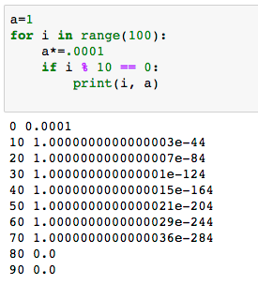
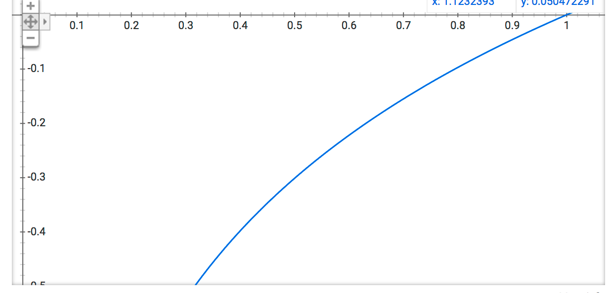
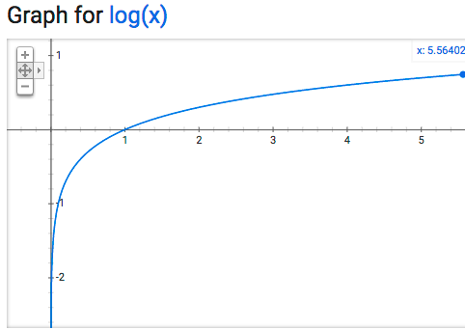
Practicalities: Underflow
Recall: for w in x: total *= wprobs[w][c]
x may be long! wprobs[w][c] may be small!
But remember log math!
exp(log(x)) = x
log(xy) = log(x)+log(y)
∀x, y > 0, x > y ⟺ log(x) > log(y)

Slide 24
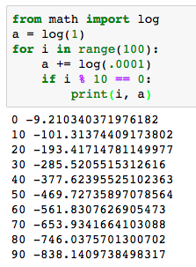
Avoiding Underflow with Logs
Now: for w in x: total += log(wprobs[w][c])

Slide 25
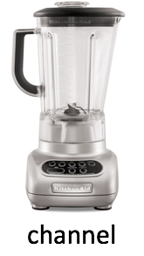


Noisy Channel Model
Reminder: Using Bayes' Rule interpretation of the world
P(C)
P(W|C)
C
W
"word to express my sentiment"
"pos"
"great"
"I will generate a positive review"
decode

Slide 26
Feature Engineering: getting better results
In general we call the elements of the representation we feed to a classifier/learner/predictor/etc. features (note: different sources may use different language here)
So far, we have been using single words as our features (subject to a particular definition of what a word is)
What else about a review might give us clues as to its sentiment?

Slide 27
Other Features
Bigrams ("not good", "Wall Street")
Aside: NLPish for lengths of word sequence: unigram, bigram, trigram, 4-gram, ...
normalized unigrams
root form: "like" (instead of "liked", "liking", etc.) (cf. morphology lecture)
uncapitalized ("great!!!" instead of "Great!!!", "GREAT!!!")
punc-normalized ("Great!" instead of "Great!!!", "Great!!!!!")
spelling correction ("great" instead of "greate"...or "grate"??)
length of the document (maybe positive reviews are shorter?)
average (max? min?) length of words
other properties
contains sequence of all-caps words
author id
time of writing
Much of this is application-dependent; try it out and see what works!

Slide 28
Naive Bayes Assumption Revisited
Naive Bayes Assumption: P(A_{1,} A_{2,} ...|B) = P(A₁|B)P(A₂|B)...
Feature choice can make this assumption more naive!
P(san) = 11/160
P(francisco) = 7/160
P(san, francisco) = 7/160 ≈ .04
P(san)*P(francisco) = 77/25600 ≈ .003
Consequence: parts of the input that are overrepresented by features have more influence
Analogy: ask 5 people what they thought of the movie, but they all ask the same person and repeat what she said.

Slide 29
Feature Engineering in Labeling Tasks
We've been making a single classification decision about a whole document but this can apply to other tasks
Named Entity Recognition (NER): Where are mentions of People, Organizations, Countries, etc?
Words Sense Disambiguation (WSD): make semantic decisions for ambiguous words (e.g. 'interest', 'bank')
Part of Speech (POS) Tagging: are these words nouns, adjectives, etc? (but see next lecture)
Let's look at a WSD example:
x = "Wall Street vets raise concerns about interest rates , politics"
interest sense 1: "financial". interest sense 2: "nonfinancial"
We'll call the features of x 𝛟(x)

Slide 30
How To Choose Features?
Since we're using supervision (i.e. the data) to guide us we don't have to worry too much – unimportant features won't be discriminating
But it's helpful to know something about your domain when designing features
are subword units important?
is metadata important?
is there something very particular about the task at hand that should be checked (e.g. detecting the writings of a psychopath who only writes in sentences with a prime number of words)
Should I just use every possible feature I can think of?
More features => more flexibility
More features => more expensive to train
More features => more overfitting

Slide 31
What Features? What Parameters? How to Choose?
Most of these questions are empirical: do what works best on the task you have at hand
But beware overfitting: doing well on your training data and then doing poorly on blind test data
Typically we divide labeled data up as follows:
Training data: used to build model parameters (e.g. P(good|"pos"))
Development/tuning data: used to test different hyperparameters/models (e.g. which α in Lidstone smoothing)
Test data: estimate how well you'll do on new/blind data. Don't evaluate on this until you're done/nearly done with experiments!

Slide 32
Feature Engineering for WSD
𝛟(x)
bias | 1
capitalized? | 0
#wordsBefore | 6
#wordsAfter | 3
relativeOffset | 0.66
leftWord=about | 1
leftWord=best | 0
rightWord=rates | 1
rightWord=in | 0
Wall | 1
Street | 1
vets | 1
best | 0
in | 0
Wall Street | 1
Street vets | 1
vets raise | 1
bias feature (≈ class prior):
value of 1 for every x so
learned weight reflects
prevalence of the class
x = Wall Street vets raise concerns about interest rates , politics
Input represented as a table of features with real values (often binary)
In practice: define feature templates , e.g. "leftWord=*" which yield many specific features

Slide 33
Feature Engineering for WSD
𝛟(x)
bias | 1
capitalized? | 0
#wordsBefore | 6
#wordsAfter | 3
relativeOffset | 0.66
leftWord=about | 1
leftWord=best | 0
rightWord=rates | 1
rightWord=in | 0
Wall | 1
Street | 1
vets | 1
best | 0
in | 0
Wall Street | 1
Street vets | 1
vets raise | 1
spelling feature
x = Wall Street vets raise concerns about interest rates , politics
Input represented as a table of features with real values (often binary)
In practice: define feature templates , e.g. "leftWord=*" which yield many specific features

Slide 34
Feature Engineering for WSD
𝛟(x)
bias | 1
capitalized? | 0
#wordsBefore | 6
#wordsAfter | 3
relativeOffset | 0.66
leftWord=about | 1
leftWord=best | 0
rightWord=rates | 1
rightWord=in | 0
Wall | 1
Street | 1
vets | 1
best | 0
in | 0
Wall Street | 1
Street vets | 1
vets raise | 1
x = Wall Street vets raise concerns about interest rates , politics
token positional features
Input represented as a table of features with real values (often binary)
In practice: define feature templates , e.g. "leftWord=*" which yield many specific features

Slide 35
Feature Engineering for WSD
𝛟(x)
bias | 1
capitalized? | 0
#wordsBefore | 6
#wordsAfter | 3
relativeOffset | 0.66
leftWord=about | 1
leftWord=best | 0
rightWord=rates | 1
rightWord=in | 0
Wall | 1
Street | 1
vets | 1
best | 0
in | 0
Wall Street | 1
Street vets | 1
vets raise | 1
x = Wall Street vets raise concerns about interest rates , politics
immediately neighboring words
Input represented as a table of features with real values (often binary)
In practice: define feature templates , e.g. "leftWord=*" which yield many specific features

Slide 36
Feature Engineering for WSD
𝛟(x)
bias | 1
capitalized? | 0
#wordsBefore | 6
#wordsAfter | 3
relativeOffset | 0.66
leftWord=about | 1
leftWord=best | 0
rightWord=rates | 1
rightWord=in | 0
Wall | 1
Street | 1
vets | 1
best | 0
in | 0
Wall Street | 1
Street vets | 1
vets raise | 1
x = Wall Street vets raise concerns about interest rates , politics
unigrams
Input represented as a table of features with real values (often binary)
In practice: define feature templates , e.g. "leftWord=*" which yield many specific features

Slide 37
Feature Engineering for WSD
𝛟(x)
bias | 1
capitalized? | 0
#wordsBefore | 6
#wordsAfter | 3
relativeOffset | 0.66
leftWord=about | 1
leftWord=best | 0
rightWord=rates | 1
rightWord=in | 0
Wall | 1
Street | 1
vets | 1
best | 0
in | 0
Wall Street | 1
Street vets | 1
vets raise | 1
x = Wall Street vets raise concerns about interest rates , politics
Input represented as a table of features with real values (often binary)
In practice: define feature templates , e.g. "leftWord=*" which yield many specific features
bigrams

Slide 38
Feature Engineering for WSD
𝛟(x)
w₁
w₂
X = Wall Street vets raise concerns about interest rates , politics
log(P(c₁))
bias | 1
capitalized? | 0
#wordsBefore | 6
#wordsAfter | 3
relativeOffset | 0.66
leftWord=about | 1
leftWord=best | 0
rightWord=rates | 1
rightWord=in | 0
Wall | 1
Street | 1
vets | 1
best | 0
in | 0
Wall Street | 1
Street vets | 1
vets raise | 1
log(P(c₂))
weights learned
by NB
Shouldn't these be more important?
log(P(...|c₁))
Iterate over
all possible features
argmax_{c} w_{c}^{T}𝛟(x)
for c in classes:
total = log(class_probs[c])
for w in x:
total += log(wprobs[w][c])
totals.append(total)
return argmax(totals)
log(P(vets|c₁))
log(P(vets|c₂))
Can we be more general?

Slide 39
Feature Engineering for WSD
𝛟(x)
w₁
w₂
3
bias | 1
capitalized? | 0 | -3.0 | -6/2
#wordsBefore | 6 | .22 | .15
#wordsAfter | 3 | -.01 | .03
relativeOffset | 0.66 | 1.00 | .85
leftWord=about | 1 | 0 | 0
leftWord=best | 0 | -2.0 | 3.0
rightWord=rates | 1 | 5.0 | -1.2
rightWord=in | 0 | -1 | -0.5
Wall | 1 | .8 | -.4
Street | 1 | 2.0 | .3
vets | 1 | ... | ...
best | 0
in | 0
Wall Street | 1
Street vets | 1
vets raise | 1
2.4
X = Wall Street vets raise concerns about interest rates , politics
less important
argmax_{c} w_{c}^{T}𝛟(x)
Important!
Sure, let's just come up with
weights from some other source!
How about just choosing whatever
weights make the classifier better?

Slide 40
Slight Notation Correction
𝛟(x)
w₁
w₂
Wall | 1 | .8 | -.4
We've been treating features as a function of just X, with a weight vector for each possible class
Going forward we'll treat features as a function of X and Y, with a single weight vector
The forms are equivalent but this form makes generalizing to many classes easier
argmax_{c} w_{c}^{T}𝛟(x)
𝛟(x,y)
w
Wall ^ y=1 | 1 | .8
Wall ^ y=2 | 0 | -.4
argmax_{c} w^{T}𝛟(x,c)

Slide 41
Perceptron: An Error-Driven Learner/Classifier
import numpy as np
from classifier import feats, classify
w = np.zeros(|feats|)
for i in range(iterations):
for t in range(datasize):
x, y = select(X, Y)
# run current classifier
y' = classify(x, w)
if y' != y:
w += feats(x, y)-feats(x, y')
return w
C is a subroutine of L
X
Y
L
C
def classify(x, w):
scores = []
for y in labelspace:
scores.append(np.dot(w, feats(x,y)))
return argmax(scores)

Slide 42
What's Going On Here (I)?
X = Wall Street vets raise concerns about interest rates , politics
if y' != y:
w += feats(x, y)-feats(x, y')
If the wrong decision was made...
Extra weight is given to features that should have fired (but didn't)
extra penalty is given to features that did fire (but shouldn't have).
Features that wouldn't have fired anyway are left alone
𝛟(x,1)
𝛟(x,2)
w
bias ^ y=1 | 1 | 0 | 0.3
bias ^ y=2 | 0 | 1 | 0.7
Wall ^ y=1 | 1 | 0 | .8
Wall ^ y=2 | 0 | 1 | -.2
this ^ y=1 | 0 | 0 | 2.2
1.3
-.3
1.8
-1.2
2.2
Notes:
Suppose x is class 1, and we predict it to be class 2,
If 2!=1:
W+= feats(x, 1)-feats(x, 2)
Argmax (wt dot feat(x,y))
=[0.3, 0.7, 0.8, -.2, 2.2].[1,0|0,1|1,0|0,1|0,0] = [0.3+0.8, 0.7-0.2] = argmax [1.1, 0.5] = class 1
After
Argmax[1.3+1.8, -0.3-1.2] = [3.1, -1.5] = more towards class 1

Slide 43
What's Going On Here (II)?
Each (x, y) is a point in |feature|-dimensional space.
Weights define a hyperplane (line) along which score is zero
Perceptron moves the line to encourage correct items to be positive distance away

Slide 44
What's Going On Here (III)?
Let's say we have pair (x, y). Perceptron chooses argmax_{y'} w^{T}𝛟(x,y'); let the chosen y' be y*.
Ideally y*=y; since we choose the argmax, we know that w^{T}𝛟(x,y*)-w^{T}𝛟(x,y) >= 0. That value is called the loss; the bigger it is the worse our classifier is.
We get to choose w. Specifically we'd like to find argmin_{w'}w^{'T}𝛟(x,y*)-w'^{T}𝛟(x,y). This is a differentiable and continuous function, so take the derivative and move away from it.

Slide 45
Loss Gradient for Perceptron
𝓁_{perceptron} = wT𝛟(x,y*)-w^{T}𝛟(x,y) unless the two are equal, then it's 0.
remember, w is a vector, so the gradient is taken for each member
however each variable appears exactly twice in the expanded equation
∂/∂w 𝓁_{perceptron} = 𝛟(x,y*)-𝛟(x,y) (unless the two are equal...)
And we want a negative step, so 𝛟(x,y)-𝛟(x,y*) (unless the two are equal)
Notes:
TODO: graph of what we're minimizing! (negative slope of equation where y = loss,

Slide 46
Other Perceptron Notes
Since it's not closed-form like NB, weights need to be iteratively updated for some length of time. How long? Black art.
What order to process the data? Probably randomly shuffle, but experimentally determined
Avoiding overfitting
Averaging: Keep track of all weight vectors learned, then average them
Early stopping: Check performance on a dev set, then stop when it stops improving
Support Vector Machine (SVM): Variant of perceptron trying to get the separating hyperplane farthest away from all points.

Slide 47
Perceptron Vs. Naive Bayes
Perceptron
Naive Bayes
Discriminative model; can only classify given x
Not probabilistic
Iterative solution
No independence assumption; arbitrary feats
Best for more accuracy (esp. SVM), medium data, more feats
Can overfit
Generative model; can be used to estimate P(x) or generate x from y
Probabilistic
Closed-form solution
Overlapping features violate independence assumption
Best for speed, lowish data, simple features

Slide 48
Can We Use All These Weights and Still Be Probabilistic?
Being probabilistic allows us to quantify our uncertainty, work in pipelines, but the arbitrary weights of perceptron are freeing. Any way to have the best of both worlds?
Recall, that the Naive Bayes objective, P(X|Y)P(Y) = P(X, Y), which is also P(Y|X)P(X)
In classification we're given X; we don't really need to worry about it. So if we don't want to be generative (since we're not making the Naive Bayes Assumption) we just need a good model for P(Y|X)
We have a score function for the event Y, X... w^{T}𝛟(x,y)...what can we do?

Slide 49
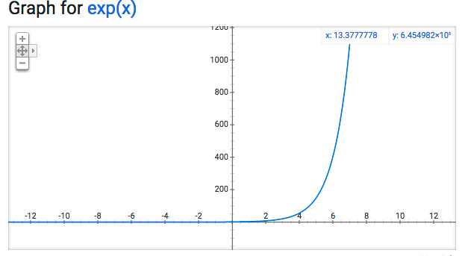
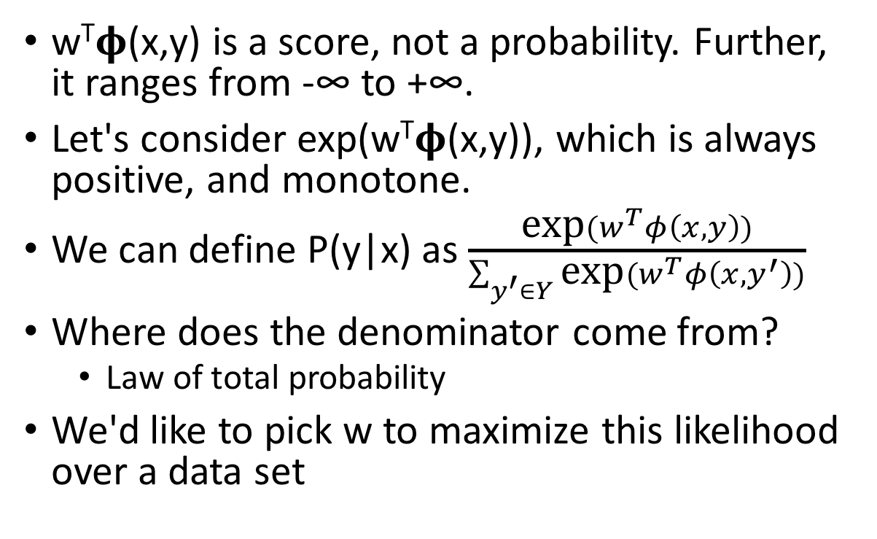
Making the score function probabilistic
w^{T}𝛟(x,y) is a score, not a probability. Further, it ranges from -∞ to +∞.
Let's consider exp(w^{T}𝛟(x,y)), which is always positive, and monotone.
We can define P(y|x) as $\frac{\text{exp}(w^{T}φ\left(x, y\right))}{\sum_{y^{′}∈Y}{\text{exp}(w^{T}φ\left(x, y^{′}\right))}}$
Where does the denominator come from?
Law of total probability
We'd like to pick w to maximize this likelihood over a data set
These slides based on notes of Jacob Eisenstein

Slide 50
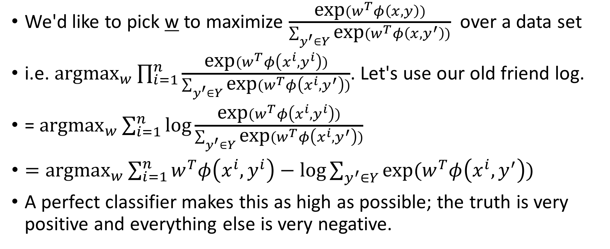
Maximizing Likelihood = Maximizing log likelihood
We'd like to pick w to maximize $\frac{\text{exp}(w^{T}φ\left(x, y\right))}{\sum_{y^{′}∈Y}{\text{exp}(w^{T}φ\left(x, y^{′}\right))}}$ over a data set
i.e. ${\text{argmax}}_{w}\prod_{i=1}^{n}{\frac{\text{exp}(w^{T}φ\left(x^{i}, y^{i}\right))}{\sum_{y^{′}∈Y}{\text{exp}(w^{T}φ\left(x^{i}, y^{′}\right))}}}$. Let's use our old friend log.
= ${\text{argmax}}_{w}\sum_{i=1}^{n}{\text{log}\frac{\text{exp}(w^{T}φ\left(x^{i}, y^{i}\right))}{\sum_{y^{′}∈Y}{\text{exp}(w^{T}φ\left(x^{i}, y^{′}\right))}}}$
$={\text{argmax}}_{w}\sum_{i=1}^{n}{w^{T}φ\left(x^{i}, y^{i}\right)−\text{log}\sum_{y^{′}∈Y}{\text{exp}(w^{T}φ\left(x^{i}, y^{′}\right))}}$
A perfect classifier makes this as high as possible; the truth is very positive and everything else is very negative.

Slide 51
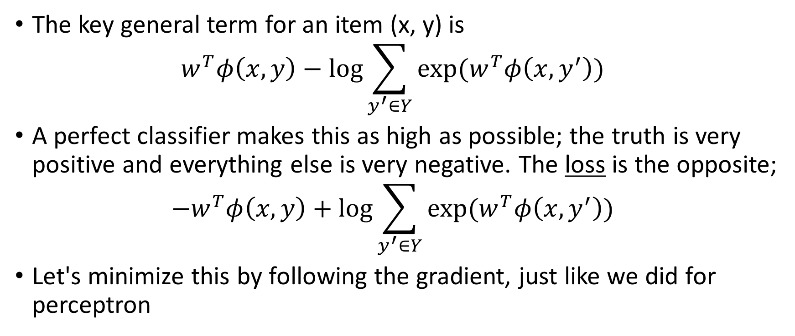
Maximizing Log Likelihood = Minimizing Log Loss
The key general term for an item (x, y) is $w^{T}φ\left(x, y\right)−\text{log}\sum_{y^{′}∈Y}{\text{exp}(w^{T}φ\left(x, y^{′}\right))}$
A perfect classifier makes this as high as possible; the truth is very positive and everything else is very negative. The loss is the opposite; ${−w}^{T}φ\left(x, y\right)+\text{log}\sum_{y^{′}∈Y}{\text{exp}(w^{T}φ\left(x, y^{′}\right))}$
Let's minimize this by following the gradient, just like we did for perceptron

Slide 52
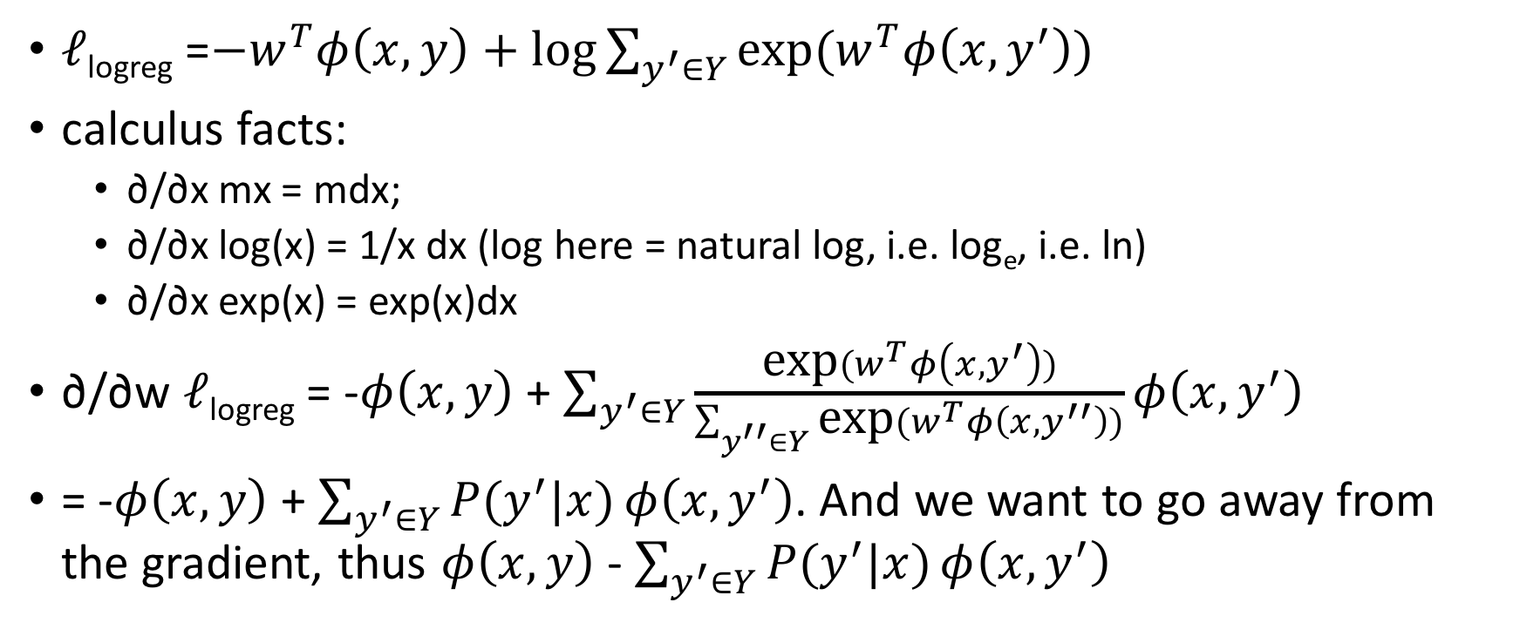
Loss Gradient for Logistic Regression (aka Maximum Entropy)
𝓁_{logreg} =${−w}^{T}φ\left(x, y\right)+\text{log}\sum_{y^{′}∈Y}{\text{exp}(w^{T}φ\left(x, y^{′}\right))}$
calculus facts:
∂/∂x mx = mdx;
∂/∂x log(x) = 1/x dx (log here = natural log, i.e. log_{e}, i.e. ln)
∂/∂x exp(x) = exp(x)dx
∂/∂w 𝓁_{logreg} = -$φ\left(x, y\right)$ + $\sum_{y^{′}∈Y}{\frac{\text{exp}(w^{T}φ\left(x, y^{′}\right))}{\sum_{y^{′′}∈Y}{\text{exp}(w^{T}φ\left(x, y^{′′}\right))}}}φ\left(x, y^{′}\right)$
= -$φ\left(x, y\right)$ + $\sum_{y^{′}∈Y}{P(y^{′}|x)}φ\left(x, y^{′}\right)$. And we want to go away from the gradient, thus $φ\left(x, y\right)$ - $\sum_{y^{′}∈Y}{P(y^{′}|x)}φ\left(x, y^{′}\right)$

Slide 53

Gradient Update of Logistic Regression vs Perceptron
Perceptron: w+=𝛟(x,y)-𝛟(x,y*); considers the single wrong decision, move away by constant amount
Logreg: $w+=φ\left(x, y\right)$ - $\sum_{y^{′}∈Y}{P(y^{′}|x)}φ\left(x, y^{′}\right)$; consider every alternative decision, move away by the model's confidence in that amount

Slide 54
Perceptron Vs. Logistic Regression
Perceptron
Logistic Regression
Discriminative model
Not probabilistic
Iterative solution
No independence assumption
Easy to write
Medium-fast to learn
Can overfit
Discriminative model
Probabilistic
Iterative solution
No independence assumption
Slow to write
Slow to learn
Foundation of deep learning optimization
Can overfit

Slide 55
Conclusions
We have seen how training data and supervised learning can produce a better classifier
Classifier takes an input (such as a text document) and predicts an output (such as a class label)
Learner takes training data and produces (statistics necessary for) the classifier

Slide 56
Conclusions
Because most pieces of text are unique, it's not very practical to assume the one being classified is in the training data
though it is in the library of Babel!
We need to make modeling assumptions that help the learner to generalize to unseen inputs
The Naive Bayes model and Bag of Words assumption are a simple, fast probabilistic approach to text classification
The Perceptron allows more arbitrary features at the cost of slower learning and a requirement of more data
Logistic Regression adds probabilities back into the arbitrary feature and weight capability of perceptron
Notes:
Logistic model: logit = log(p/(1-p) ) is linear combination of variables (features). Regression because there is some true prob and we're trying to find it exactly.

